Slide 1
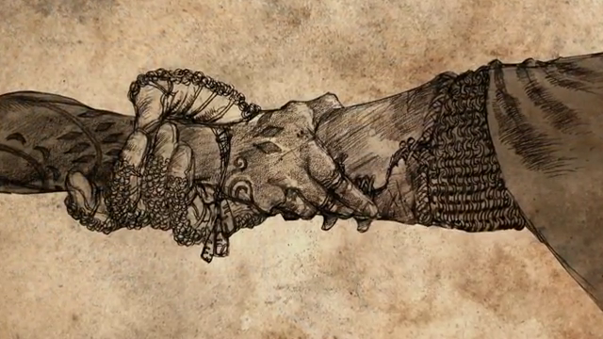
Consumer driven contract testing
With Pact
Notes:
Hi,
For the next 15 or so minutes I will be talking about consumer driven contract tests.
More specifically I will be telling a story related to this concept and I’ll be using Pact, one of the available consumer contract testing frameworks, to illustrate the example.
The story begins with a pizza shop. We all know those right? Most of us have eaten pizza in a (maybe recent) past?

Slide 2
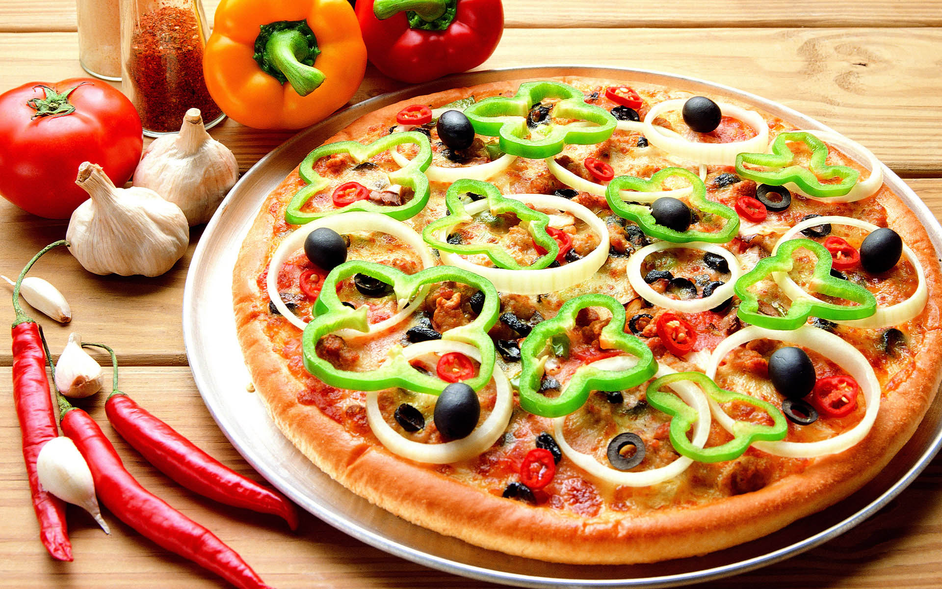
Notes:
For the sake of the story I’ve given this shop a name and they sell large pizzas, small ones, pizzas with vegetables and pizzas with meat and so on and so forth.
But now, they provide a public API to expose their menu for every internet connected pizza fan.
Who can possibly be a consumer of the API in this scenario?
I can at least think of 1 party.

Slide 3





Ordina
Costs
Size
Notes:
The most obvious one, it’s us, Ordina
What matters to Ordina is size and price of the pizza.
We’ll see why in a second.
Secondly we have an international guest.

Slide 4
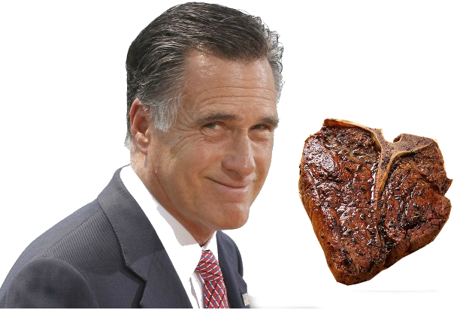
Meat Romney
Meat
A lot of it
Notes:
We’ve got meat romney (or his IT team) using the API as well.
He absolutely needs to know, which pizzas have meat, a lot of meat.
Let’s see what that looks like as a whole.

Slide 5
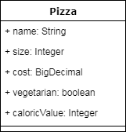



Queenslizepizza
Notes:
Pretty straight forward, 3 consumers using the API provided by Queenslizepizza
Let’s get a bit more into Consumer driven contract and Pact then

Slide 6
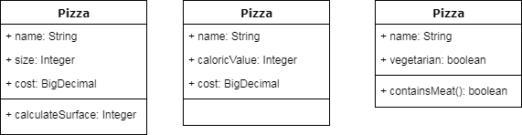
Integration Test
Given that there are pizzas When I get the menu
Then I can see which ones have meat in them
So I can order the meatiest one
Queenslizepizza
Notes:
So Meat Romney he’s only interested in the meatiest of pizzas
He doesn’t care about the price nor the caloric value or any of that other nonsensical pizza information.
He creates an integration test which in time will generate a pact file.
The pact file is the contract Meat has with QueenslizePizza

Slide 7
Integration Test
Given that there are pizzas When I get the menu
Then we can see the price and diameter of them
So we can use these numbers in the BU meeting
Queenslizepizza
Notes:
Maarten and Wonne need information about the cost of the pizzas and their diameter so they can use it on a BU meeting slide.
Every client has now created the contract that contains the way they use the API, including general structure, fields, types, ...

Slide 8

Notes:
In comes pact
What Pact will do with those integration tests is transform the interactions between consumer and provider to a JSON file
This json file or pact-file will now be available for verification on the provider side.
They have to get them to Queenslize in some way.
Thankfully there are plenty of ways

Slide 9


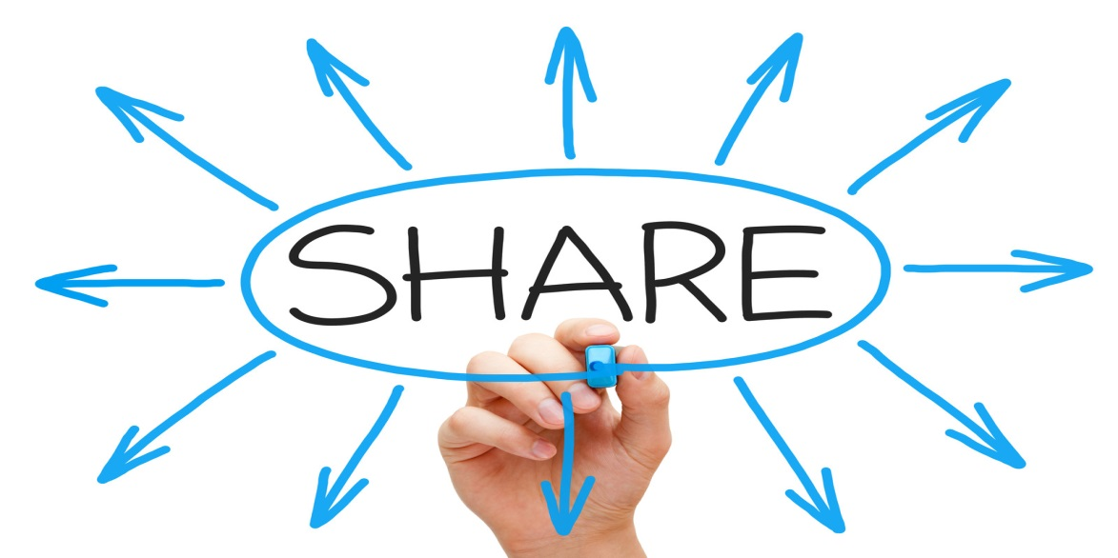



Notes:
As it’s just a json file, the pact files can be commited into source control
Published as a jar
Copied on a USB stick and mailed to Queenslize, looking at you Meat Romney
Or dropped in a FTP that Queenslize provided
Pact provides a Pact-broker that acts as an intermediate service to publish pacts and can also be used for providers to get the latest version of the pacts. That way they’re always up to date.
Is the provider able to verify all pact-files in its current state of our example??
*switch to running Queenslize API to give a general impression of what the actual API looks like*

Slide 10

Notes:
Meat is a-okay

Slide 11





Notes:
Maarten and Wonne are Happy
So Ordina is happy too
All pacts are verified unless....

Slide 12


Ann Hannah
New client
Pineapple
➔To the backlog !
Notes:
Ann Hannah is a new client, she has a strong interest in pineapple.
But that’s not supported at all right now.
The Queenslizepizza team use her pact to generate a story in the backlog.
Pineapple support, coming soon !

Slide 13
€ != $
Notes:
Meanwhile the business has seen that there is an American customer shopping specifically at Queenslize.
There must be a way to get more money out of this, they say.
Euros aren’t Dollars they say, so they make a high priority change request to be able to charge more.
The team still has to discuss the possible options

Slide 14

Notes:
“How about I just change the price field to be a String and then I’ll add a eurosign or dollarsign to it, it’ll be in production tonight”

Slide 15
Notes:
Our square yellow friend changes the API and commits his changes.
The CD does its job and as a last step before pushing to production it will verify the pact files.
Meat Romney’s contract is filled in just like before, no problem here.
Time for the cash to start rolling in from the united states

Slide 16



Notes:
Ow chucks
Build failed
Making the change to the price field breaks the contract with Ordina and Daisy.
Alarms go off around the office and yellow square developer has to come clean as to what he’s done. With dire consequences !

Slide 17
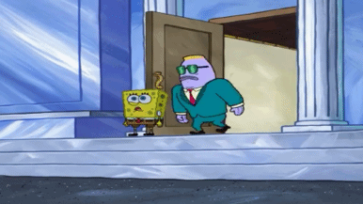

Slide 18
Notes:
Meanwhile pineapple support has arrived to the Queenslize API. Ann Hannah’s wish is granted and her pact is now verified at the provider side.
Now every contract with every known client is honored and the new feature Ann requested is in place.
The developers can start thinking about a better solution for the currency problem.
To conclude

Slide 19
Consumer driven contract testing
Layer of comfort
Usage, how, which endpoints, ...
Great for µServices
Pacts are usually small
Lots of back and forth internally
Best if communication lines are short
Notes:
What are reasons to do consumer driven contract testing
Lastly Pact in a nutshell:

Slide 20
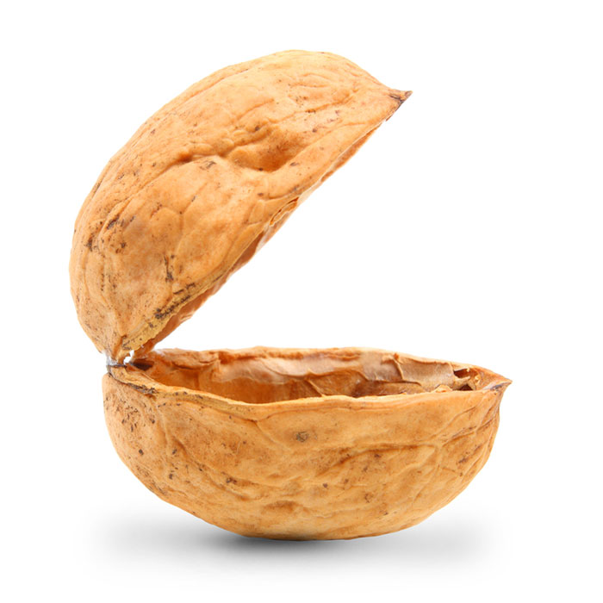

Multilanguage support
Java
Javascript
Ruby
Go
....
Readable contract
JSON
Nice features
Broker
Documentation

Slide 21
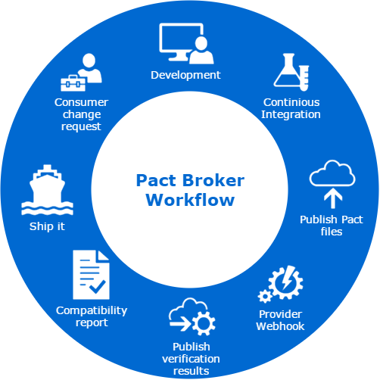
Pact Broker

Slide 22
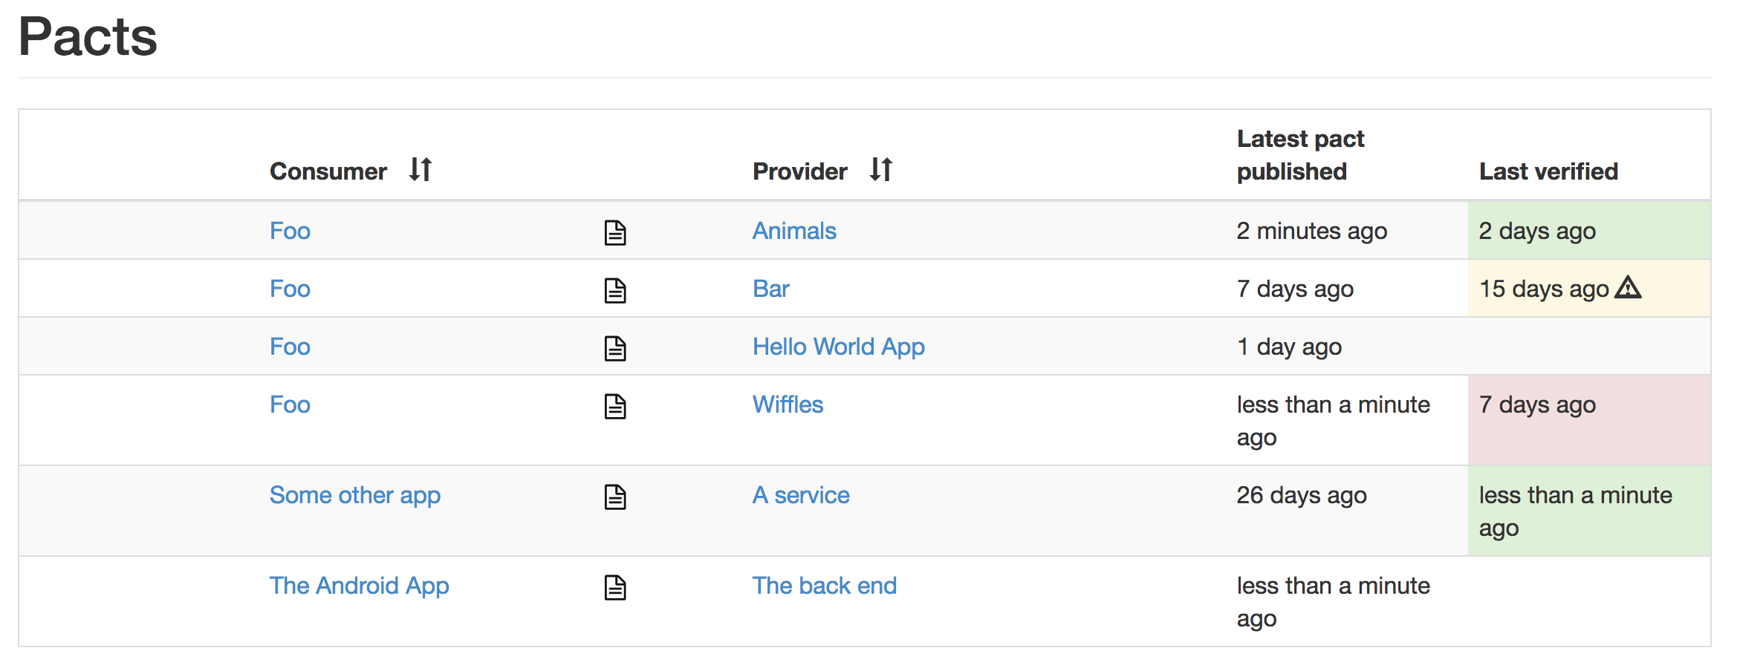

Slide 23

Interested?
pact.io & docs.pact.io
Demo @ /Hpacquee/lightning-pact
Have questions or want to see it in action?
Stay a little, have a drink
Come hava a talk

